Slide 1
CSC 362: Systems Programming
Lecture 23
Original slides by: Amitabha Dey
Adapted by: Dr. Richard Johnson
Department of Computer Science
University of North Carolina at Greensboro

Slide 2

What we will cover in Networking
OSI Model - 7 Layers
TCP/IP Model
Client-Server Model
Socket Programming
UDP, TCP
Host Byte Order to Network Byte Order Conversion
Socket Functions
connect, bind, listen, accept, send, receive, close
Network Security
Malware, DoS Attacks, MitM Attacks, Phishing, etc.
Virtualization & Containers
Dockers

Slide 3
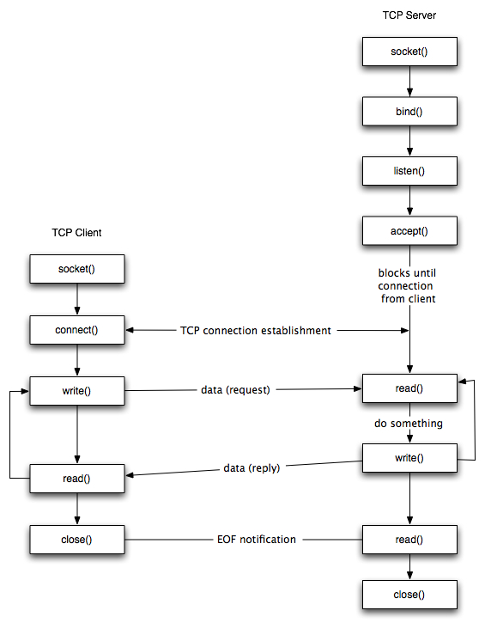
Image credit - https://www.cs.dartmouth.edu/
Notes:
---
Short Description
A flowchart showing the sequential socket API calls for a TCP client-server interaction,
from connection establishment to data exchange and termination.
Long Description
The diagram consists of two vertical columns: the TCP Client on the left and the TCP Server on the right.
Arrows indicate the flow of execution and the network messages sent between the two entities.
1. Connection Establishment
Server Side: The process begins with the server calling socket(), followed by bind() to a specific port, and listen() to wait for incoming connections. It then calls accept(), which blocks execution until a client attempts to connect.
Client Side: The client calls socket() and then connect(). This initiates the TCP connection establishment (the three-way handshake), which unblocks the server’s accept() call.
2. Data Exchange Loop
Request: The client calls write() to send a data request. On the server side, this is received via a read() call.
Processing: The server "does something" with the data and then calls write() to send a data reply.
Response: The client receives the reply via a read() call. Both sides have arrows indicating this process can loop for multiple requests and replies.
Connection Termination
Closing: Once the interaction is complete, the client calls close().
EOF: This sends an EOF (End of File) notification to the server.
Finalization: The server’s final read() identifies the EOF, and the server then calls close() to terminate its end of the connection.

Slide 4
The steps for establishing a TCP socket on the client side are the following:
Create a socket using the socket() function;
Connect the socket to the address of the server using the connect() function;
Send and receive data by means of the read() and write() functions.
Image credit - https://www.cs.dartmouth.edu/
Notes:
Client-Side TCP Steps
Step 1: Create a socket using the socket() function.
Step 2: Connect to the server's address using connect().
Step 3: Exchange data using read() and write() functions.

Slide 5
The steps involved in establishing a TCP socket on the server side are as follows:
The steps for establishing a TCP socket on the client side are the following:
Create a socket with the socket() function;
Bind the socket to an address using the bind() function;
Listen for connections with the listen() function;
Accept a connection with the accept() function system call. This call typically blocks until a client connects with the server.
Send and receive data by means of send() and receive().
Create a socket using the socket() function;
Connect the socket to the address of the server using the connect() function;
Send and receive data by means of the read() and write() functions.
Image credit - https://www.cs.dartmouth.edu/
Notes:
Server-Side TCP Steps
Step 1: Create a socket using socket().
Step 2: Bind the socket to a local address using bind().
Step 3: Listen for incoming connection requests with listen().
Step 4: Accept a connection with accept(), which typically blocks until a client connects.
Step 5: Send and receive data via send() and receive().

Slide 6
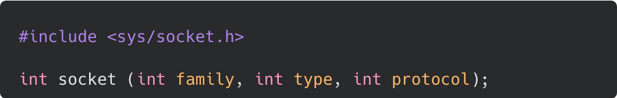
The socket() Function
The socket() function is used to create a new socket.
Notes:
Overview
The socket() function is used to create a new socket for both clients and servers.
Client-side: Used to establish a connection to a server.
Server-side: Used to create a socket that listens for incoming client requests.

Slide 7
The socket() Function
Client-side socket(): In the client application, the socket() function is used to create a new socket that will be used to establish a connection to a server.
Notes:
Overview
The socket() function is used to create a new socket for both clients and servers.
Client-side: Used to establish a connection to a server.
Server-side: Used to create a socket that listens for incoming client requests.

Slide 8
The socket() Function
Server-side socket(): In the server application, the socket() function is used to create a new socket that will be used to listen for incoming connection requests from clients.
Notes:
Overview
The socket() function is used to create a new socket for both clients and servers.
Client-side: Used to establish a connection to a server.
Server-side: Used to create a socket that listens for incoming client requests.

Slide 9
The socket() Function
family: This parameter specifies the address family or domain of the socket. An address family is a set of protocols that can communicate with each other.
AF_INET: IPv4 address family.
AF_INET6: IPv6 address family.
AF_UNIX or AF_LOCAL: Local communication within the same system using Unix domain sockets.
Notes:
family Parameter
Specifies the address family/domain:
AF_INET (IPv4),
AF_INET6 (IPv6), or
AF_UNIX/AF_LOCAL (local system communication).

Slide 10
The socket() Function
type: This parameter determines the communication semantics for the socket. It specifies whether the socket will be used for connection-oriented (stream-based) or connectionless (datagram-based) communication.
SOCK_STREAM: Provides a reliable, two-way, connection-based byte stream (e.g., TCP sockets).
SOCK_DGRAM: Provides an unreliable, connectionless datagram service (e.g., UDP sockets).
Notes:
type Parameter
Determines communication semantics:
SOCK_STREAM for reliable, connection-based byte streams (TCP) or
SOCK_DGRAM for connectionless datagrams (UDP).

Slide 11
The socket() Function
protocol: This parameter specifies the specific protocol to be used with the socket. Typically, this argument is set to 0, indicating that the system should choose the default protocol based on the specified address family and socket type.
IPPROTO_TCP: Transmission Control Protocol (TCP).
IPPROTO_UDP: User Datagram Protocol (UDP).
IPPROTO_ICMP: Internet Control Message Protocol (ICMP).
Notes:
protocol Parameter
Specifies the protocol (e.g., IPPROTO_TCP, IPPROTO_UDP, IPPROTO_ICMP).
Often set to 0, letting the system choose the default protocol based on the family and type.
---
For Reference:
The Internet Control Message Protocol (ICMP)
is a network layer protocol used by devices (like routers)
to send error messages and operational information,
such as unreachable hosts or time-to-live (TTL) expiration.
It is essential for network diagnostics (ping/traceroute) and works alongside IP,
though it does not guarantee reliable delivery.

Slide 12
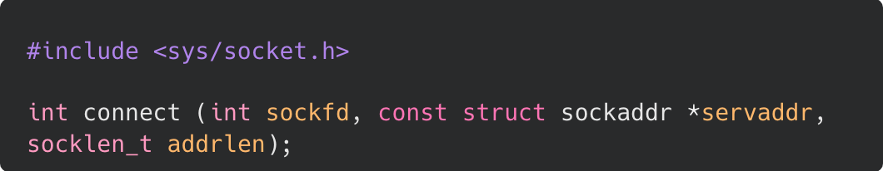
The connect() Function
The connect() function in socket programming is used by a client to establish a connection to a remote server. Its primary purpose is to initiate a connection-oriented communication session between the client and the server.
Notes:
Purpose and sockfd
Used by clients to initiate a connection-oriented session with a remote server.
The sockfd parameter is the file descriptor for the local socket previously created by socket().

Slide 13
The connect() Function
sockfd: This parameter is the file descriptor of the socket that you want to establish a connection with. It represents the local socket that you want to connect from. The socket must have been previously created with the socket() function.
Notes:
Purpose and sockfd
Used by clients to initiate a connection-oriented session with a remote server.
The sockfd parameter is the file descriptor for the local socket previously created by socket().

Slide 14
The connect() Function
For a client application:
The client creates a socket using the socket() function, which returns a socket file descriptor (sockfd). This socket represents the client's endpoint.
The client then uses the connect() function to establish a connection to a remote server. The sockfd passed to connect() is the file descriptor of the client's socket.
Notes:
Client Application Flow
The client creates a socket (sockfd) and then calls connect() to reach the server.

Slide 15
The connect() Function
For a server application:
The server creates a listening socket using the socket() function, which returns a socket file descriptor (sockfd). This socket is used to accept incoming connections from clients.
After a connection is accepted using accept() (typically in a separate thread or process), a new socket is created to communicate with the specific client. This new socket is returned by accept() and is used for communication with that client. The original listening socket (sockfd) remains open to accept more connections from other clients.
Notes:
Server Application Context
The server uses a listening socket to accept connections.
After accept() returns a new socket for specific client communication,
the original listening socket remains open for other clients.

Slide 16
The connect() Function
servaddr: This should point to a properly initialized struct sockaddr containing the address and port number of the server to connect to. The address family (e.g., AF_INET for IPv4 or AF_INET6 for IPv6) should match the address family of the socket created.
Notes:
servaddr Parameter
Points to a struct sockaddr containing the server's IP and port.
The address family must match the socket's created family (e.g., AF_INET).

Slide 17
The connect() Function
addrlen: This should be set to the size of the address structure pointed to by servaddr. For example, if you are using IPv4, it would typically be sizeof(struct sockaddr_in).
Notes:
addrlen Parameter
Specifies the size of the address structure (e.g., sizeof(struct sockaddr_in) for IPv4).

Slide 18
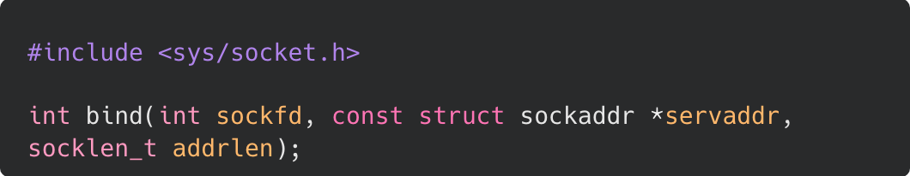
The bind() Function
The bind() function in socket programming is used to associate a socket with a specific network address and port number on the local machine. Its primary purpose is to bind a unique identifier to the socket, allowing other processes to communicate with it using that address.
Notes:
Purpose and Identification
Associates a socket with a specific local IP address and port number.
Allows other processes to uniquely identify and communicate with the socket over the network.

Slide 19
The bind() Function
Assigning a Local Address: The bind() function assigns a local address to the socket, which includes both an IP address and a port number. This allows the socket to be uniquely identified within the network. The IP address specifies the network interface on the local machine, and the port number specifies the application or service running on that machine.

Slide 20
The bind() Function
Socket Identification: By binding a socket to a specific address and port, the bind() function allows other processes on the same machine or on remote machines to connect to or send data to that socket. This enables communication between processes running on different machines over a network.

Slide 21
The bind() Function
sockfd: This parameter is the file descriptor of the socket that you want to bind. It represents the local socket that you want to associate with a specific network address and port number. The socket must have been previously created with the socket() function.
Notes:
bind() Parameters
sockfd: The descriptor of the socket to be bound.
servaddr: A pointer to the local address information.
addrlen: The size of the address structure, usually set using `sizeof`.

Slide 22
The bind() Function
servaddr: This parameter is a pointer to a struct sockaddr that contains the address information (IP address and port number) you want to bind to the socket. It represents the local address to which you want to bind the socket. The struct sockaddr is a generic structure used to represent socket addresses and must be properly initialized.
Notes:
bind() Parameters
sockfd: The descriptor of the socket to be bound.
servaddr: A pointer to the local address information.
addrlen: The size of the address structure, usually set using `sizeof`.

Slide 23
The bind() Function
addrlen: This parameter specifies the size of the address structure pointed to by servaddr. It indicates the length of the address structure passed in the servaddr parameter. This parameter is typically set using the sizeof operator.
Notes:
bind() Parameters
sockfd: The descriptor of the socket to be bound.
servaddr: A pointer to the local address information.
addrlen: The size of the address structure, usually set using `sizeof`.

Slide 24
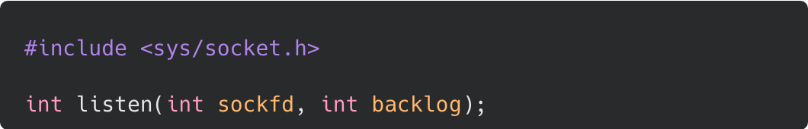
The listen() Function
The listen() function in socket programming is used by a server to mark a socket as passive, meaning that it will be used to accept incoming connection requests from clients.
Its primary purpose is to prepare a socket for incoming connections and to specify the maximum number of pending connections that can be queued up waiting for acceptance.
Notes:
listen() Function
Marks a socket as "passive" to accept incoming connections.
sockfd: The descriptor of a socket that has already been created and bound.
backlog: Defines the maximum number of pending connections that can wait in the queue before being rejected.

Slide 25
The listen() Function
sockfd: This parameter is the file descriptor of the socket that you want to start listening on. The socket must have been previously created with the socket() function and bound to a local address using the bind() function. This descriptor uniquely identifies the socket in the operating system.
Notes:
listen() Function
Marks a socket as "passive" to accept incoming connections.
sockfd: The descriptor of a socket that has already been created and bound.
backlog: Defines the maximum number of pending connections that can wait in the queue before being rejected.

Slide 26
The listen() Function
backlog: This parameter defines the maximum length of the queue of pending connections for the socket. It indicates how many incoming connections can be queued up waiting for the server to accept them. If the number of pending connections exceeds this limit, additional connection attempts may be rejected by the operating system.
Notes:
listen() Function
Marks a socket as "passive" to accept incoming connections.
sockfd: The descriptor of a socket that has already been created and bound.
backlog: Defines the maximum number of pending connections that can wait in the queue before being rejected.

Slide 27
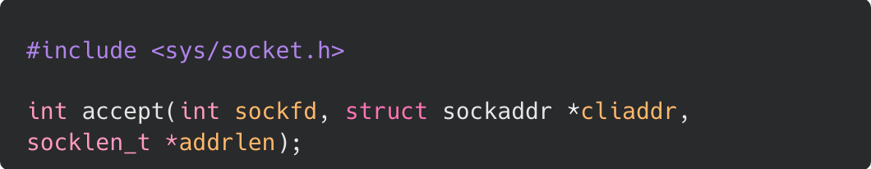
The accept() Function
The accept() function in socket programming is used by a server to accept a connection request from a client. Its primary purpose is to create a new socket for communicating with the client that initiated the connection request.
Notes:
accept() Function
Purpose and sockfd
Used by servers to accept a connection request and create a new socket for communicating with that specific client.
sockfd refers to the original listening socket.

Slide 28
The accept() Function
sockfd: It is the socket file descriptor, which is a unique identifier for the socket. It identifies the listening socket that is waiting for incoming connection requests. The socket must have been previously created with the socket() function, bound to a local address using the bind() function, and set to the listening state using the listen() function.
Notes:
accept() Function
Purpose and sockfd
Used by servers to accept a connection request and create a new socket for communicating with that specific client.
sockfd refers to the original listening socket.

Slide 29
The accept() Function
cliaddr: This is a pointer to a struct sockaddr that will be filled in by accept() with the address information of the client that is connecting to the server. It represents the address of the client. The struct sockaddr is a generic structure used to represent socket addresses and must be properly initialized. Depending on the address family (e.g., IPv4 or IPv6), it can be cast to struct sockaddr_in or struct sockaddr_in6 for IPv4 and IPv6 respectively.
Notes:
cliaddr: A pointer to a structure that `accept()` fills with the connecting client's address information.

Slide 30
The accept() Function
addrlen: This is a pointer to a socklen_t variable that specifies the size of the address structure pointed to by cliaddr. It indicates the length of the address structure that accept() can fill in. After accept() returns, it updates the value of addrlen with the actual size of the client's address.
Notes:
addrlen: Initially specifies the size of the buffer; `accept()` updates it with the actual size of the client's address upon return.

Slide 31
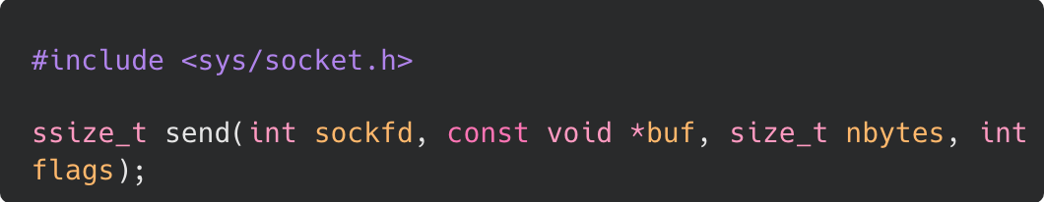
The send() Function
The send() function in socket programming is used to send data on a connected socket.
Notes:
The send() Function
Sends data through a connected socket.
Parameters:
sockfd (must be connected),
buf (pointer to data),
nbytes (number of bytes to send), and
flags (behavior modifiers like `MSG_DONTWAIT` or `MSG_NOSIGNAL`).

Slide 32
The send() Function
sockfd: This parameter is the file descriptor of the socket that you want to send data through. The socket must be in a connected state, meaning that it has already been established either by calling connect() for TCP sockets or accept() for server-side sockets.
Notes:
Parameters:
sockfd (must be connected),
buf (pointer to data),
nbytes (number of bytes to send), and
flags (behavior modifiers like `MSG_DONTWAIT` or `MSG_NOSIGNAL`).

Slide 33
The send() Function
buf: This parameter is a pointer to the data that you want to send. It points to the memory location where the data is stored. The data can be of any type, but it is typically a buffer containing bytes to be transmitted.
Notes:
Parameters:
sockfd (must be connected),
buf (pointer to data),
nbytes (number of bytes to send), and
flags (behavior modifiers like `MSG_DONTWAIT` or `MSG_NOSIGNAL`).

Slide 34
The send() Function
nbytes: This parameter specifies the number of bytes to send from the buffer pointed to by buf. It indicates the size of the data that you want to send.
Notes:
Parameters:
sockfd (must be connected),
buf (pointer to data),
nbytes (number of bytes to send), and
flags (behavior modifiers like `MSG_DONTWAIT` or `MSG_NOSIGNAL`).

Slide 35
The send() Function
flags: This parameter is used to modify the behavior of the send() function. It can be set to various flag values to control aspects of the transmission, such as setting socket options or specifying how the data should be sent.
0: Default behavior.
MSG_DONTWAIT: Enables non-blocking operation. The send() function returns immediately, even if the socket is not ready for writing.
MSG_NOSIGNAL: Prevents the generation of SIGPIPE signals if the remote end of the connection is closed.
Notes:
Parameters:
sockfd (must be connected),
buf (pointer to data),
nbytes (number of bytes to send), and
flags (behavior modifiers like `MSG_DONTWAIT` or `MSG_NOSIGNAL`).
---
For reference:
In network programming, MSG_NOSIGNAL is a flag used with the send() system call to handle one of the more annoying default behaviors in Unix-like systems: the SIGPIPE signal.
The Problem: Broken Pipes
By default, if you attempt to write data to a socket that has been closed by the remote peer (a "broken pipe"),
the kernel doesn't just return an error. Instead, it sends a SIGPIPE signal to your process.
The Default Result: If you haven't explicitly handled or ignored this signal, your application will immediately terminate.
The Logic: This behavior dates back to early Unix pipeline design (e.g., cat file | head), where if the reader (head) finishes and closes its input, the writer (cat) should stop immediately.
The Solution: MSG_NOSIGNAL
Passing this flag tells the kernel:
"If this send fails because the connection is dead, don't signal me. Just return an error and let me handle it in the code."

Slide 36
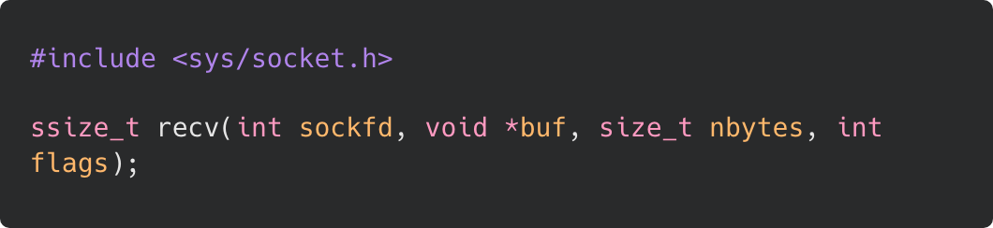
The receive() Function
The recv() function in socket programming is used to receive data from a connected socket.
Notes:
The receive() Function
Receives data from a connected socket into a buffer.
Parameters:
sockfd,
buf (destination buffer),
nbytes (max bytes to receive), and
flags (e.g., `MSG_WAITALL` to block until the full amount is received).

Slide 37
The receive() Function
sockfd: This parameter is the file descriptor of the socket from which you want to receive data. The socket must be in a connected state, meaning that it has already been established either by calling connect() for TCP sockets or accept() for server-side sockets.
Notes:
Parameters:
sockfd,
buf (destination buffer),
nbytes (max bytes to receive), and
flags (e.g., `MSG_WAITALL` to block until the full amount is received).

Slide 38
The receive() Function
buf: This parameter is a pointer to the buffer where the received data will be stored. It points to the memory location where the data will be placed after it is received. The buffer should be large enough to accommodate the incoming data.
Notes:
Parameters:
sockfd,
buf (destination buffer),
nbytes (max bytes to receive), and
flags (e.g., `MSG_WAITALL` to block until the full amount is received).

Slide 39
The receive() Function
nbytes: This parameter specifies the maximum number of bytes to receive into the buffer pointed to by buf. It indicates the size of the buffer and limits the amount of data that will be received in a single call to recv().
Notes:
Parameters:
sockfd,
buf (destination buffer),
nbytes (max bytes to receive), and
flags (e.g., `MSG_WAITALL` to block until the full amount is received).

Slide 40
The receive() Function
flags: This parameter is used to modify the behavior of the recv() function. It can be set to various flag values to control aspects of the reception, such as setting socket options or specifying how the data should be received. Common flag values include 0 for default behavior or MSG_WAITALL to block until the full amount of requested data is received.
Notes:
Parameters:
sockfd,
buf (destination buffer),
nbytes (max bytes to receive), and
flags (e.g., `MSG_WAITALL` to block until the full amount is received).

Slide 41
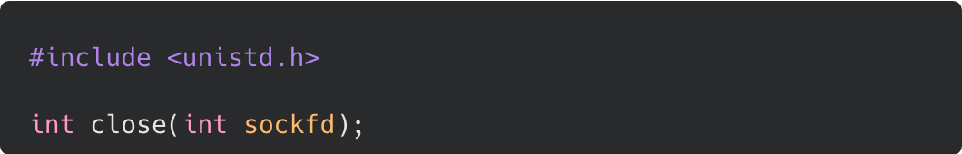
The close() Function
The close() function is used to close a file descriptor, including those associated with sockets.
sockfd: This parameter is the file descriptor of the socket that you want to close. In the context of socket programming, sockfd represents the socket that you have been working with, and you want to release the associated resources and close the communication channel.
Notes:
The close() Function
Closes the socket file descriptor, releasing associated resources and ending the communication channel.

